Slide 1
Revealing race equity issues
How do we use data to uncover new problem narratives?
Notes:
Exploring how to use data to reveal race equity issues

Slide 2

Presenter & Introductions
Name
Affiliation
Do you start your day with coffee or tea or ??
Holly J. White-Wolfe,
Research Assistant
Center for the Future of Arizona
holly.white-wolfe@arizonafuture.org
PhD Student
Justice Studies and Social Inquiry
School of Social Transformation
hwhitewo@asu.edu

Slide 3
Is neglect poor parenting?
Or is it tied to economic hardship and structural racism?
Notes:
Project I spent the last year working on that is culminating in an invited manuscript submission to the Child Welfare Journal’s special issue on poverty.

Slide 4
Acknowledgments
Raphael Charron-Chenier, Assistant Professor ASU
Co-author on project
Lead on visualization development
Ramona Denby-Brinson
Co-author on project
Distributive justice inspiration

Slide 5
Foster care entry facts
Child welfare agencies in the United States separate non-White children from their families and place them in foster care at much greater rate than White children (Dettlaff, 2014; Pac, Waldfogel, & Wimer, 2017; Roberts, 2002).
Non-White children also stay in substitute care for longer periods and are less likely than White children to be reunified with their family (Farrow, Meltzer, Notkin, & Miller, 2014; Roberts, 2002; Summers, 2016; White, 2017).
Determinations of child neglect play an important role in foster care placements: neglect is cited as a reason for removal in roughly 60% of foster care cases (U.S. Department of Health and Human Services, 2018).

Slide 6
narratives
While child welfare practitioners often conceptualize neglect as a consequence of poor parenting (Dubowitz, 2013), many scholars argue instead that “neglect” captures instead the consequences of economic hardship (Bullinger, Feely, Raissian, & Schneider, 2019; Kim & Drake, 2018) and structural racism (Curtis & Denby, 2011).
Racial disparities in family separations can be understood as:
a consequence of institutional racism in the child welfare system (Curtis & Denby, 2011; Roberts, 2002),
racial inequality in families’ access to material resources (Wulczyn, Feldman, Horwitz, & Alpert, 2013),
and racial inequality in exposure to stressors (Wulczyn, Gibbons, Snowden, & Lery, 2013).
Notes:
The narrative around neglect has been focused on poor parenting and most resources go to parenting behavior change interventions.
We wanted to reframe neglect as economic hardship and structural racism, which we could highlight using community-level data about poverty and other stressors.

Slide 7
How could data challenge assumptions?
Are there methods we can use that better reveal race equity issues?

Slide 8
Four methods
Selecting variables and controls that contextualize family experiences
Get more granular than aggregated population
Use race-specific measures
Use density plots to reveal experience frequencies

Slide 9
Select variables and controls that put family experiences in context
Table 1. Incidence rate ratio and standard error estimates from models of county foster care entry
 | Model 1 |  | Model 2 |  | Model 3 |  | Model 4 |  | Model 5
County Entry Rate
Poverty (%) |  |  | 1.072 | *** |  |  |  |  | 1.076 | ***
 |  |  | 0.019 |  |  |  |  |  | 0.024
Unemployment (%) |  |  |  |  | 1.015 |  |  |  | 0.942 | *
 |  |  |  |  | 0.022 |  |  |  | 0.023
Renter occupancy (%) |  |  |  |  |  |  | 1.088 | *** | 1.05 | *
 |  |  |  |  |  |  | 0.023 |  | 0.023
Residential segregation | 1.003 |  | 0.999 |  | 1.003 |  | 1.007 |  | 1.002
 | 0.006 |  | 0.005 |  | 0.006 |  | 0.005 |  | 0.005
Population density (log) | 1.01 |  | 0.973 |  | 1.016 |  | 0.852 | * | 0.86 | *
 | 0.084 |  | 0.066 |  | 0.088 |  | 0.058 |  | 0.057
2015 | 0.937 |  | 0.908 | * | 1.005 |  | 0.868 | ** | 0.647 | ***
 | 0.041 |  | 0.04 |  | 0.112 |  | 0.039 |  | 0.083
Constant | 0.001 | *** | 0.001 | *** | 0.001 | *** | 0.001 | *** | 0.001 | ***
 | 0 |  | 0 |  | 0 |  | 0 |  | 0
Alpha (log) | 0.41 | *** | 0.334 | *** | 0.409 | *** | 0.339 | *** | 0.29 | ***
 | 0.083 |  | 0.06 |  | 0.082 |  | 0.064 |  | 0.048
N | 224 |  | 224 |  | 224 |  | 224 |  | 224
AIC | 3283 |  | 3255 |  | 3285 |  | 3263 |  | 3242
BIC | 3300 |  | 3276 |  | 3305 |  | 3284 |  | 3270
* p<0.05, ** p<0.01, *** p<0.001
Notes:
Most work on community-level resources had focused on the impact of poverty rates on child maltreatment (Kim & Drake, 2018; Maguire-Jack, Lanier, Johnson-Motoyama, Welch, & Dineen, 2015).
In this paper, we broaden that focus by examining the role of several community-level economic hardships on foster care entry rates for Black, Latino, and White children.
Prior research suggests that non-White families disproportionately experience poverty, job insecurity, and restricted wealth-building capacity (Curtis & Denby, 2011). These are all elements of distributive injustice, which are paper worked to put forward as a new narrative.
Broadening the types of hardships examined is helpful for understanding the specific mechanisms driving racialization of foster care entry, for designing anti-racist policy interventions, and for identifying opportunities for effective social mobilization by families victimized by current practices.

Slide 10
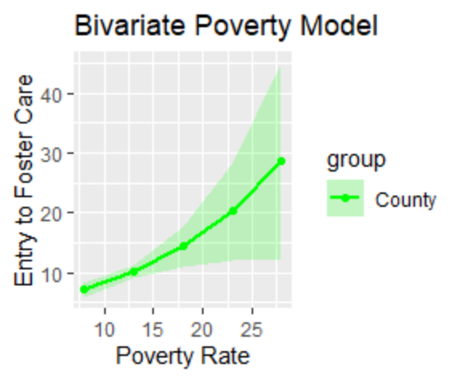
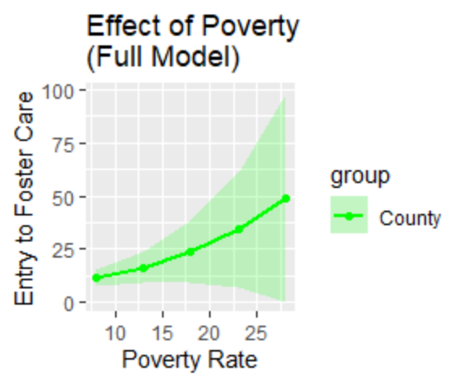
get more granular Than aggregated population
Notes:
The racial composition of many counties is still predominantly white, which means that any aggregate measure of US counties is going to largely reflect the experience of the white community.

Slide 11
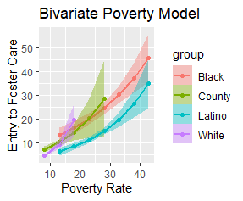
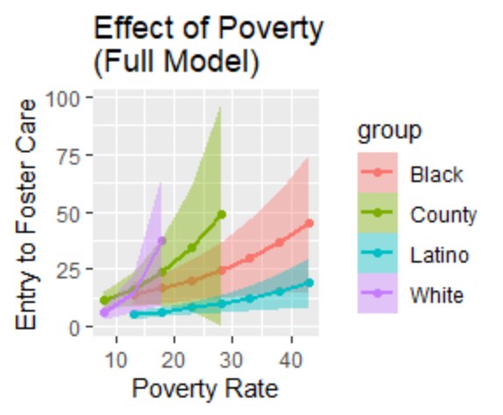
Use RACE-specific measures
Notes:
Note the green line that represents the County experience. Now look how much the experience varies by group.
Each of these lines represents a unique, race-specific model where White Foster Care Entry is predicted by the poverty rate for Whites in the Bivariate model. In the full model, we show the effect of each race’s poverty on each race’s foster care entry while controlling for unemployment and renter occupancy as additional hardship measures.
The range of the poverty rate for populations of Blacks and Latinos shows these groups experience much higher rates of poverty.

Slide 12
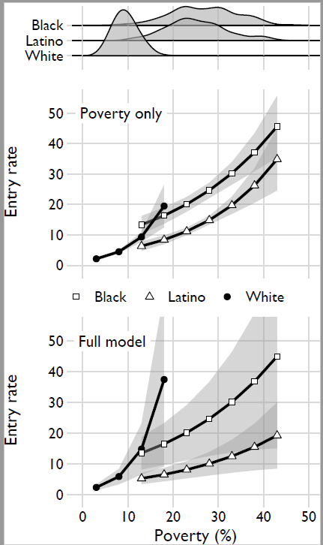
Use Density plots to reveal experience frequencies
Notes:
The final figure we created for our manuscript include a special arrangement of the data in one chart. Here we can see the effect of poverty alone and when other hardships are considered. Most importantly, we include density plots to show the frequency of these rates by population.
This allowed us to form a strong counter argument to the idea that equal levels of risk exposure would produce similar rates of entry to foster care. At 18% poverty, there is some overlap between White and Black foster care rates. However, for both groups, 18% poverty is a rarity. Very few counties have white populations living in that high of poverty, and very few counties have Black populations living in that low of poverty.

Slide 13
Other approaches to examine group differences
What other approaches do masc participants use?

Slide 14
R Notebook on examining Group differences
Can use student performance data set for practice: http://roycekimmons.com/tools/generated_data/exams (Large Data Set)
R File to Share
https://github.com/hwhitewo/R_support/blob/master/compare_groups_session.R
Uses t-tests, regression, ANOVA or ANOVA III and Tukey’s HSD for testing significance differences between groups
Includes code for plotting so you can visualize interactions and differences

Slide 15
Logistic regression modeled by group?
Table 2 Logistic regression on school failure
 | (1) | (2) | (3) | (4) | (5) | (6) | (7)
VARIABLES | Total | White | Latino | Black | American Ind. | Asian/PI | Mixed
Welfare Participation (ref. = free Lunch) Reduced-cost lunch | 0.78* | 0.72 | 0.81 | 0.73 | 1.06 | 0.95 | 0.61
 | [0.646 - 0.952] | [0.500 - 1.047] | [0.620 - 1.055] | [0.293 - 1.801] | [0.502 - 2.248] | [0.216 - 4.193] | [0.289 - 1.309]
Nonparticipant | 0.64*** | 0.59*** | 0.76** | 0.52* | 0.79 | 1.01 | 0.30***
 | [0.553 - 0.747] | [0.472 - 0.746] | [0.624 - 0.918] | [0.301 - 0.890] | [0.438 - 1.409] | [0.324 - 3.175] | [0.191 - 0.485]
Male | 1.60*** | 1.77*** | 1.49*** | 1.69 | 1.36 | 1.66 | 1.72*
 | [1.442 - 1.784] | [1.500 - 2.085] | [1.259 - 1.767] | [0.935 - 3.067] | [0.932 - 1.988] | [0.798 - 3.435] | [1.119 - 2.638]
Age | 0.96 | 1.06 | 0.90 | 0.85 | 1.24 | 0.84 | 0.93
 | [0.886 - 1.034] | [0.913 - 1.240] | [0.818 - 1.001] | [0.626 - 1.149] | [0.931 - 1.661] | [0.548 - 1.288] | [0.675 - 1.276]
Education (ref. = 8th grade) 10th Grade | 1.42*** | 1.06 | 1.63*** | 1.61 | 0.72 | 1.30 | 2.61*
 | [1.172 - 1.731] | [0.734 - 1.536] | [1.274 - 2.094] | [0.676 - 3.846] | [0.334 - 1.530] | [0.456 - 3.711] | [1.082 - 6.270]
12th Grade | 1.07 | 0.60 | 1.36 | 1.56 | 0.38 | 3.04 | 2.08
 | [0.776 - 1.476] | [0.319 - 1.116] | [0.869 - 2.121] | [0.441 - 5.541] | [0.104 - 1.409] | [0.406 - 22.795] | [0.537 - 8.040]
Race (Ref. = White) Latino | 1.29***
 | [1.120 - 1.486]
Black | 1.55**
 | [1.164 - 2.063]
American Indian | 1.97***
 | [1.440 - 2.683]
Asian Pacific Islander | 1.04
Notes: Robust cieform in brackets ;*** p<0.001, ** p<0.01, * p<0.05
Wu, Shiyou, Kalah M. Villagrana, Siobhan M. Lawler, Renee Garbe, “Free Lunch Participation and Youth Educational Outcomes: A Multi-Racial Perspective” (working paper no date)

